Slide 1

What’s new in ASP.NET Core 3.0
Scott Addie
@Scott_Addie

Slide 2


.NET Framework unsupported
WebApp.csproj
<Project Sdk="Microsoft.NET.Sdk.Web"> <PropertyGroup> <TargetFramework>netcoreapp3.0</TargetFramework> </PropertyGroup> </Project>
Notes:
ASP.NET Core 3.0 built on .NET Standard 2.1
C# 8 support
.NET Standard is first version to NOT support .NET Framework

Slide 3
Supported ASP.NET Core variants
2.2 on .NET Core 2.2
2.1 on .NET Core 2.1
2.1 on .NET Framework 4.6.x
3.0 on .NET Core 3.0
Current
Maint.
LTS
LTS
Notes:
3.1 = LTS

Slide 4
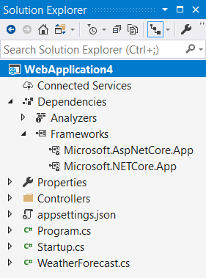
Implicit shared framework reference
Web SDK includes the following:
<ItemGroup>
<FrameworkReference Include="Microsoft.AspNetCore.App" />
</ItemGroup>
Remove metapackage reference when migrating:
<ItemGroup>
<PackageReference Include="Microsoft.AspNetCore.App" />
</ItemGroup>
Notes:
Distribution as framework instead of NuGet package

Slide 5

Assemblies removed from shared framework
Json.NET
Web API Client (Microsoft.AspNet.WebApi.Client)
Roslyn (Microsoft.CodeAnalysis.*)
EF Core
Social auth
Node Services & SPA Services
Notes:
WebApi.Client: had a dependency on Json.NET
Roslyn:
ships on the VS schedule, which differs from the .NET Core release lifecycle
some customers don’t want compilers in there for security reasons
Social auth: Facebook, Google, Microsoft, Twitter
These are NuGet packages now (previously part of shared framework in 2.x)
C:\Program Files\dotnet\shared\Microsoft.AspNetCore.App

Slide 6
Endpoint routing
Introduced in 2.2
Default in 3.0
Decouples route matching from MVC middleware
Route resolution occurs earlier in pipeline
Notes:
2.2 apps had to opt in
Dedicated middleware for this
No longer MVC-specific

Slide 7
Endpoint routing configuration
2.2
public void Configure(
IApplicationBuilder app,
IHostingEnvironment env)
{
app.UseSignalR(routes =>
{
routes.MapHub<DrawHub>("/draw");
});
}
3.0
public void Configure(
IApplicationBuilder app,
IWebHostEnvironment env)
{
app.UseRouting();
app.UseEndpoints(endpoints =>
{
endpoints.MapHub<DrawHub>("/draw");
});
}
Notes:
Map the following here:
Controllers (MVC or web API)
Health check endpoints
Razor Pages
gRPC services
SignalR hubs

Slide 8
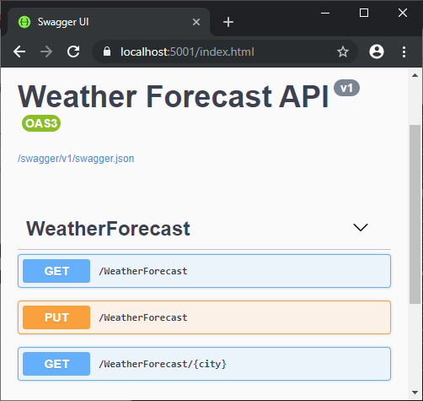
HTTP REPL
Command-line HTTP testing
Localhost
Cloud-hosted
Azure App Service
Azure Functions
Azure REST API
Endpoint navigation
Requires Swagger / OpenAPI definition
AuthN / AuthZ support
.NET Core Global Tool:
dotnet tool install –g Microsoft.dotnet-httprepl
Notes:
Requires .NET Core 2.1+
Auth schemes achievable via header manipulation
Basic authN
JWT bearer tokens
Digest authN

Slide 9
Notes:
Added Swashbuckle to starter API project

Slide 10
Developer Exception Page plain-text support
[ApiController]
[Route("[controller]")]
public class WeatherForecastController : ControllerBase
{
[HttpGet("{city}")]
public ActionResult<WeatherForecast> Get(string city)
{
if (!string.Equals(city?.TrimEnd(), "Redmond",
StringComparison.OrdinalIgnoreCase))
{
throw new ArgumentException(
$"Weather forecast unavailable for {city}.", nameof(city));
}
return GetWeather().First();
}

Slide 11

Plain-text response
cmd - httprepl
https://localhost:5001/weatherforecast> GET Chicago HTTP/1.1 500 Internal Server Error Content-Type: text/plain Date: Wed, 02 Oct 2019 01:50:48 GMT Server: Kestrel Transfer-Encoding: chunked System.ArgumentException: Weather forecast unavailable for Chicago. (Parameter 'city') at WebApplication3.Controllers.WeatherForecastController.Get(String city) in C:\Users\scaddie\source\repos\WebApplication3\Controllers\WeatherForecastController.cs:line 35 at lambda_method(Closure , Object , Object[] ) at Microsoft.Extensions.Internal.ObjectMethodExecutor.Execute(Object target, Object[] parameters)
Notes:
Plain text = default media type in 3.0

Slide 12
HTML response
cmd - httprepl
https://localhost:5001/weatherforecast> GET Chicago -h Accept=text/html HTTP/1.1 500 Internal Server Error Content-Type: text/html; charset=utf-8 Date: Wed, 02 Oct 2019 02:07:06 GMT Server: Kestrel Transfer-Encoding: chunked <!DOCTYPE html []> <html lang="en" xmlns="http://www.w3.org/1999/xhtml"> <head> <meta charset="utf-8" /> <title>Internal Server Error</title> <style> body { font-family: 'Segoe UI', Tahoma, Arial, Helvetica, sans-serif; font-size: .813em;
Notes:
Set Accept header to opt into HTML response
HTML was ONLY supported media type in < 3.0

Slide 13

gRPC
Contract-based RPC services
Messages sent/received via HTTP/2
Services & messages defined with Protobuf
Binary serialization
Notes:
Conceptually similar to WCF & .NET Remoting
We’re contributing to the open source gRPC project (https://github.com/grpc/grpc-dotnet)
In PROD, configure TLS (Transport Layer Security) to secure messages
*.proto (Protocol Buffers) files
Reduced network congestion thanks to binary serialization

Slide 14
gRPC: Protobuf
exchange_rate.proto
syntax = "proto3"; package ContosoLending.Grpc; service ExchangeRateManager { rpc GetExchangeRate (ExchangeRateRequest) returns (ExchangeRateReply) {}; } message ExchangeRateRequest { string currency_type_from = 1; string currency_type_to = 2; } message ExchangeRateReply { double exchange_rate = 1; }
Notes:
Define contract using Protobuf language
*.proto file lives on server portion (the gRPC service itself)
Clients consume *proto file
There’s no Protobuf type that maps to C# decimal type

Slide 15
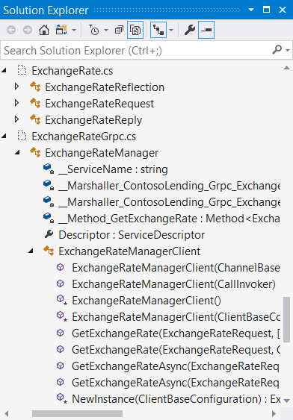
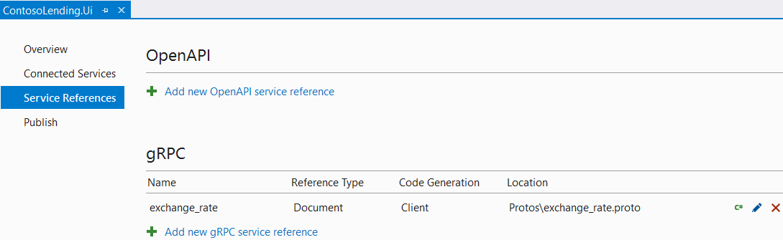
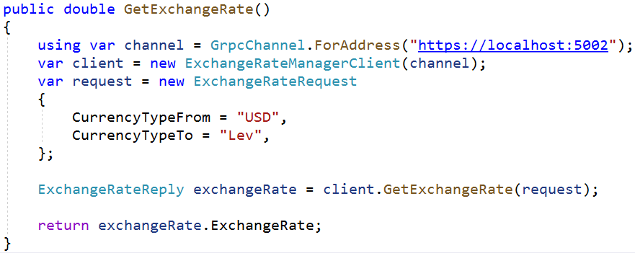
gRPC: The client
Notes:
Snake casing in *proto file converted to appropriate C# Pascal casing
Use generated members to interact w/ gRPC service
Generators for other languages (Node.js, Go, etc.)

Slide 16



Worker services
Long-running background tasks
Supported by new Worker SDK
public static IHostBuilder CreateHostBuilder(string[] args) =>
Host.CreateDefaultBuilder(args)
//.UseWindowsService()
//.UseSystemd()
.ConfigureServices(services => services.AddHostedService<Worker>());
Windows service | Systemd service
Microsoft.Extensions.Hosting.WindowsServices | Microsoft.Extensions.Hosting.Systemd
Notes:
Microsoft.NET.Sdk.Worker
Generic Host instead of Web Host
UseSystemd ignored on Windows host & UseWindowsService ignored on Linux host
Low-level building block for higher-level frameworks like Hangfire
Hangfire is more feature-rich
Technically not a web thing, but owned by ASP.NET team

Slide 17
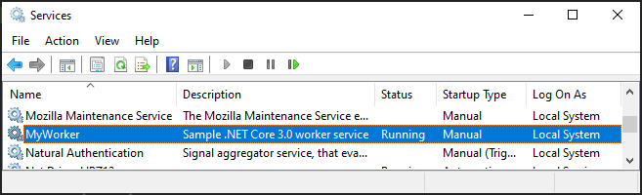
Worker service as a Windows service
> dotnet publish -o C:\pub
> sc create ContosoWorker binPath=C:\pub\ContosoWorker.exe
> sc description ContosoWorker “Sample .NET Core 3.0 worker service”
> sc start ContosoWorker
Notes:
Publish app as .exe & run Service Control Mgr. tool to create Win. service
sc.exe create <service name> <exe file path>

Slide 18
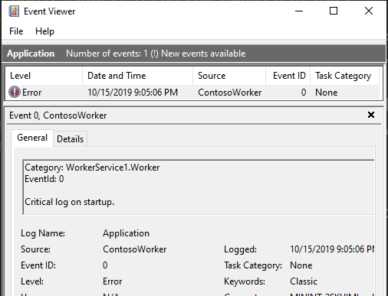
Worker service logging
public class Worker : BackgroundService
{
private readonly ILogger<Worker> _log;
public Worker(ILogger<Worker> log) =>
_log = log;
protected override async Task
ExecuteAsync(CancellationToken token)
{
_log.LogCritical(
"Critical log on startup.");
Notes:
Publish app as .exe & run Service Control Mgr. tool to create Win. service
sc.exe create <service name> <exe file path>

Slide 19
Blazor, gRPC, SignalR
DEMO
Notes:
Server-side Blazor
gRPC client & server
SignalR auto reconnect

Slide 20
Other noteworthy features
Blazor (server-side)
SignalR auto-reconnects
SignalR client-to-server streaming
SignalR hub policies
OpenAPI integration
IdentityServer integration

Slide 21
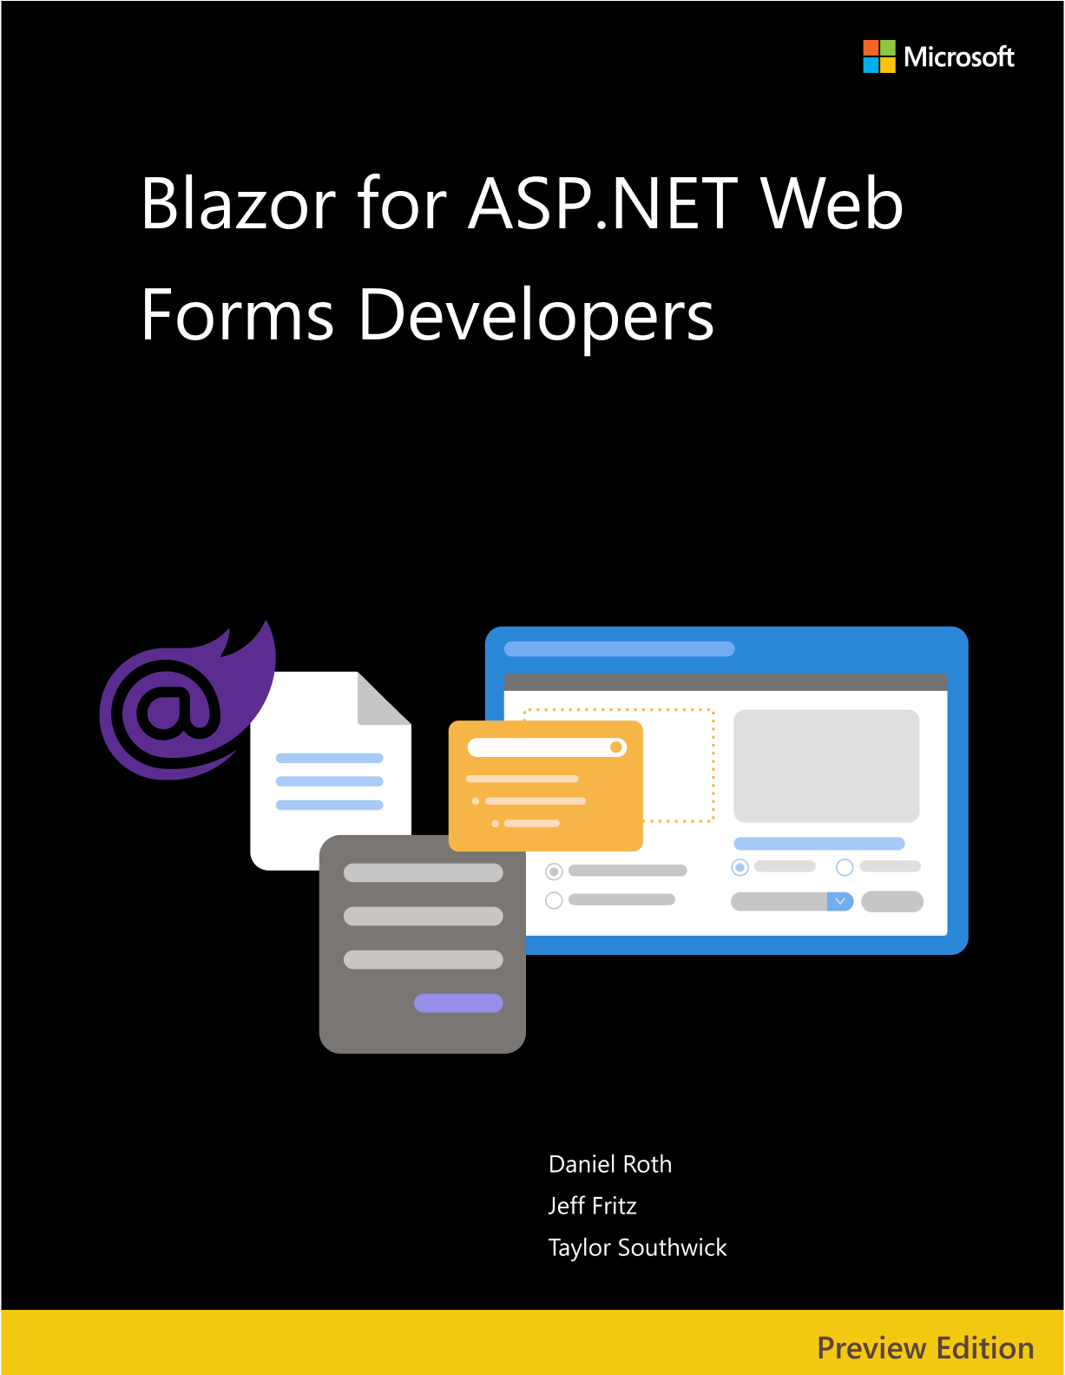


Resources
eBooks
docs.microsoft.com/dotnet/architecture/
Migration guide
aka.ms/migrate-to-3.0
Slides
aka.ms/new-in-aspnetcore3
Code
aka.ms/contoso-lending
Socials
@Scott_Addie

